Slide 1
COVID-19 DATA ANALYSIS
Raghav Kani K
January 2022

Slide 2
Outline
Scope
Design
Specification, Hypotheses, Visualization
Derived Insights
Preliminary Insights
Core Insight
Key Observation
Links to Code
Conclusion

Slide 3
Scope
The project's goal is to analyze "Covid-19" affected people.
The Corona affected people's data is from ‘Jan-2020 to July-2020’.
Analyze the people who have been affected by Covid-19 based on their country or region.
To analyze the data, we used PYTHON-Jupiter note & Visual Studio code.
The data are be visualized in a variety of charts.
In this project, we can compare the number of actives, recoveries, deaths, and so on.

Slide 4
Design
Code Perspective

Slide 5
Preliminary Insights
Calculating the actual number of people affected over the seven months period.
The data allows us to view the number of active, recovered, and deceased people in each country.
We can look at each country's pop test ratio.
Analyze and compare each country's derived statistics.
Analyzing the only entire death that has been retrieved and is still active.

Slide 6
Core insight
Specification, hypotheses, and Visualization.
Using derived data, compare the overall number of cases in each country.
Example, create a data table containing the following information.
Total number of cases.
No of active cases.
No of recovered cases.
No of Death.
Helpful in answering questions such as: Which country has been affected the most in the recent three years, based on statistics from the previous three years.
The objective of this project is to compare individual country scenarios using a correct table created using suitable commands and visualized using a table graphic (Jan-July).

Slide 7
Specification, Hypotheses, Visualization

Slide 8
Specification, Hypotheses, Visualization
The 'Covid-19 Analytics' specification for the project is to analyze each affected country and provide unique data based on different categories.
The analyses' hypotheses range from total recovery through active recovery to death. Compare the results of each country that has been affected by covid-19.We can analyze and compare data using numerous searches and receive different findings.
Following analysis, we move on to visualization, where we use Python to display the analyzed data in a table and chart.
The MS Excel used for visualizations in various chart formats, e.g. pie, bar, stacked column, and so on.

Slide 9
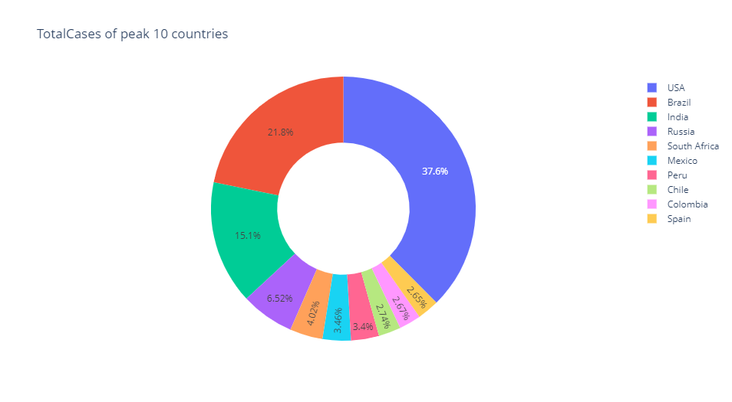
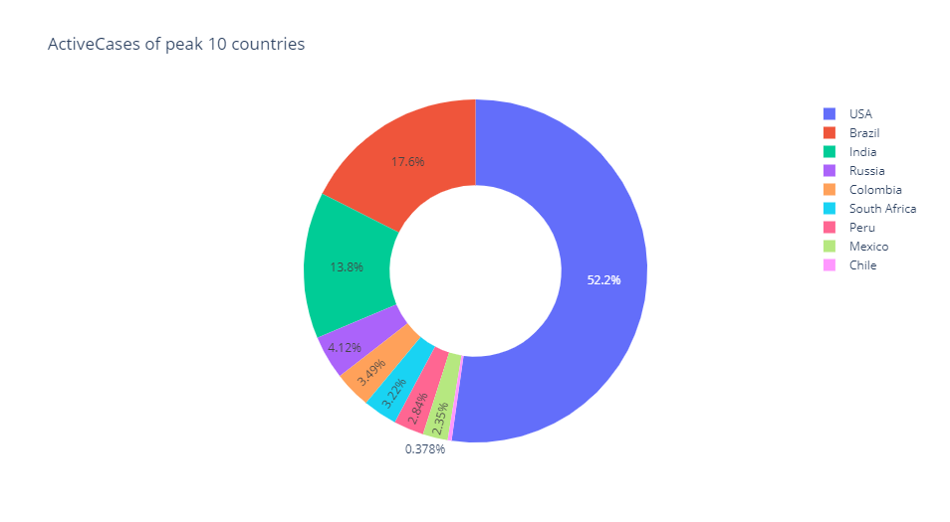
Comparison of each country
Total Cases
Active Cases

Slide 10
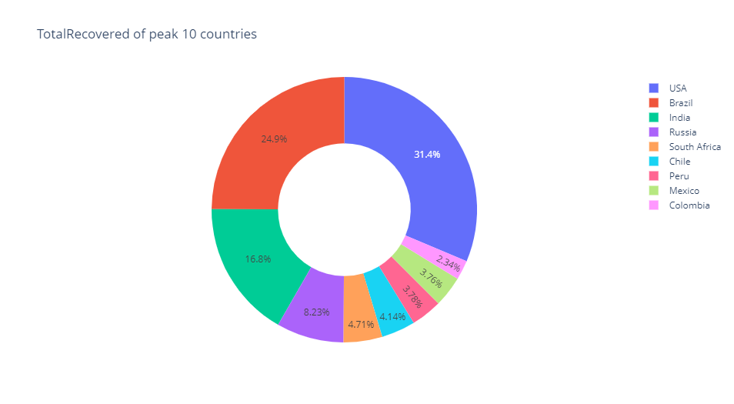
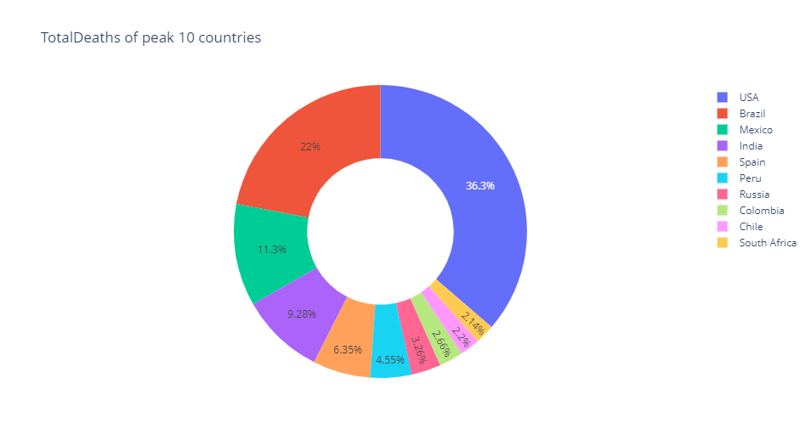
Comparison of each country
Total Recovered
Total Deaths

Slide 11
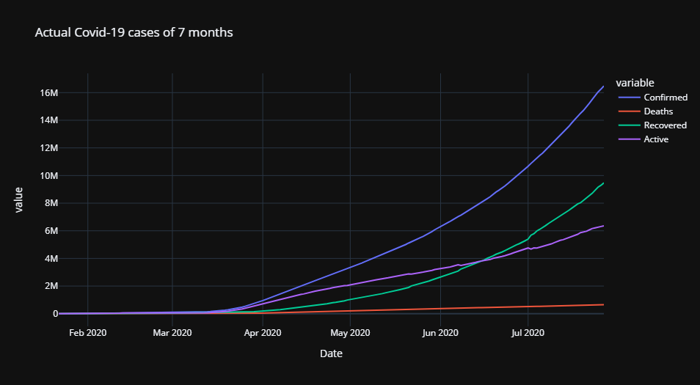
Top 10 countries data over 7 months

Slide 12
Derived Insights
Preliminary Insights (PI)
Core Insight (CI)

Slide 13
Preliminary Insights
The preliminary findings of each country study and analysis based on their affected value, tool are used for analyze and visualization are PYTHON-'Jupyter Notebook‘ & MS Excel.
PYTHON-'Jupyter Notebook': We can use Python to analyze the countries that are affected. We can extract the data and generate new data using the appropriate command.
Jupyter Nb & MS Excel: We can use Jupyter Notebook to view data in table and chart format. We may also compare the results and represent them with a chart for efficient analysis. It enables us to partition data into columns and rows.

Slide 14
Core Insight
The Core Insights of the project looked at the number of persons affected in each countries. In this study, we compared each case ratio and made new statistics based on the multiple categories.
For example, we analyzed the instances and other data of each countries. We looked at total cases, total deaths, and so on. These are the results of our project's research.
To obtain these data, we use PYTHON-'Jupyter Notebook'. We use the relevant command in PYTHON Jupyter Notebook to generate the required data. To organize data into relevant tables and visualize the generated data in various charts for easy comprehension, a jupyter notebook is employed.

Slide 15
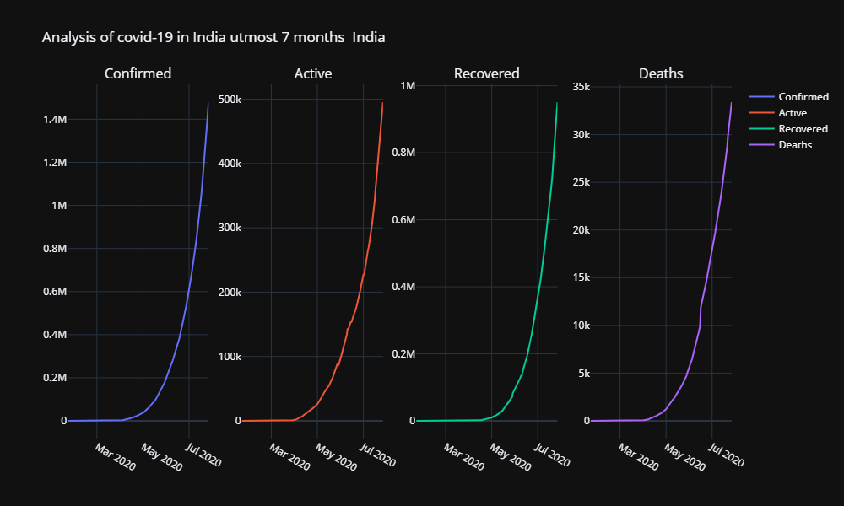
Analysis of India’s data

Slide 16
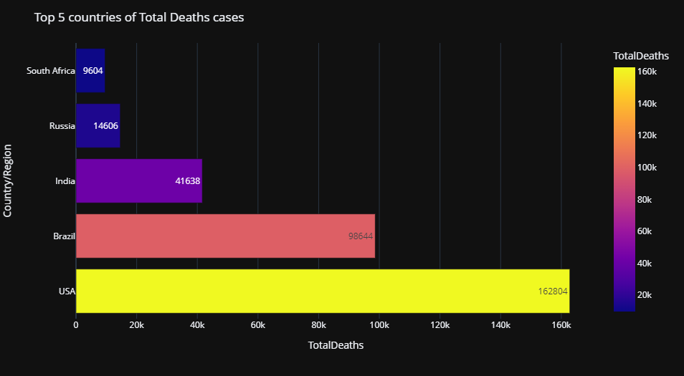
Data on cases of death
During this analysis, we derived total death data in the form of a spreadsheet - URL

Slide 17
Key Observation
In this Insight, we looked at how situations in various countries compared.
For this analysis, we used Python to filter each country's data and generate unique data for other countries.
For visualization, we used MS Excel, which is quite useful in tables and charts. We may easily assess and compare data with the help of these.
As a result of the project, we may learn about each country in different ways throughout six months.
We can also look at each country's affected ratio to evaluate where death cases are few and recovery cases are high.
The data was generated using Python and saved in table format (Pivot Table) in MS Excel, which is then formatted to a chart for better visibility and analysis.

Slide 18
Links to Code
Open code using 'Github‘, click – URL
Data Link:
Spreadsheet ‘COVID-19’ click - URL

Slide 19
Conclusion
What we did in this project?
'PYTHON-Jupyter NB' and 'MS Excel' were the tools we utilised to finish this project.
The project 'COVID-19 ANALYSIS' included analysing each and every country's cases using the data provided.
Total cases, active cases, death cases, and so on are all included in the analysis, and they are broken down by country.
We can anlayze each country's affected ratio in terms of the various categories.
We used PYTHON to generate this data, then we used MS Excel's 'table & chart' feature to show several of them.

